Slide 1
Code Review: Consolidation Exercise 3
Computer Programming and Algorithms 25/26

Slide 2
What is a code review?
Code review is a quality assurance process, where peers discuss code together to ensure or improve quality.
Very common in software engineering jobs – typically code is reviewed before being accepted as part of the “main branch”
Aim to identify bugs, logical errors, inefficiencies, edge cases.
Also used to ensure code adheres to readability and style standards.

Slide 3
How do we do a code review?
We’re going to look at some anonymized examples of code submitted for consolidation exercise 3.
We’re going to ask:
  Is this code correct?
  Is this code easy to understand?
We’ll then share and discuss our answers.

Slide 4
Is this code correct?
Does it run without errors?
  If there are errors, how big are they?
Does it produce correct output?
  Does it match the “spec”?
  Can we break it with edge cases?

Slide 5
Is this code correct?
Does it run without errors?
  If there are errors, how big are they?
Does it produce correct output?
  Does it match the “spec”?
  Can we break it with edge cases?
  Does it pass any tests?

Slide 6
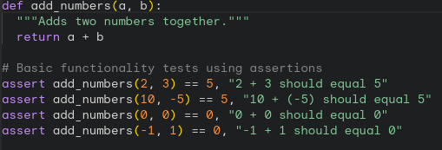
Testing Code
Testing code manually is slow and laborious - we can avoid this by writing test functions / scripts to automatically test our code.
Fundamental idea is to apply an input to a function and ensure the output is what’s expected.

Slide 7
Testing Code
Testing code manually is slow and laborious - we can avoid this by writing test functions / scripts to automatically test our code.
Fundamental idea is to apply an input to a function and ensure the output is what’s expected.
Important to do this for all key functions- not just the “main” function.

Slide 8
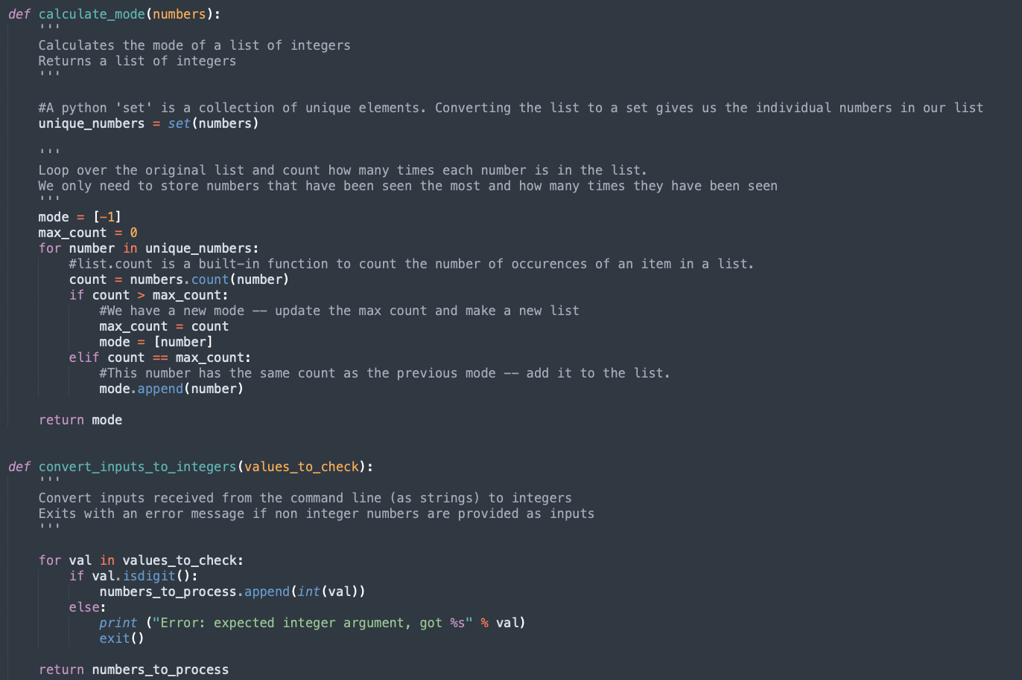
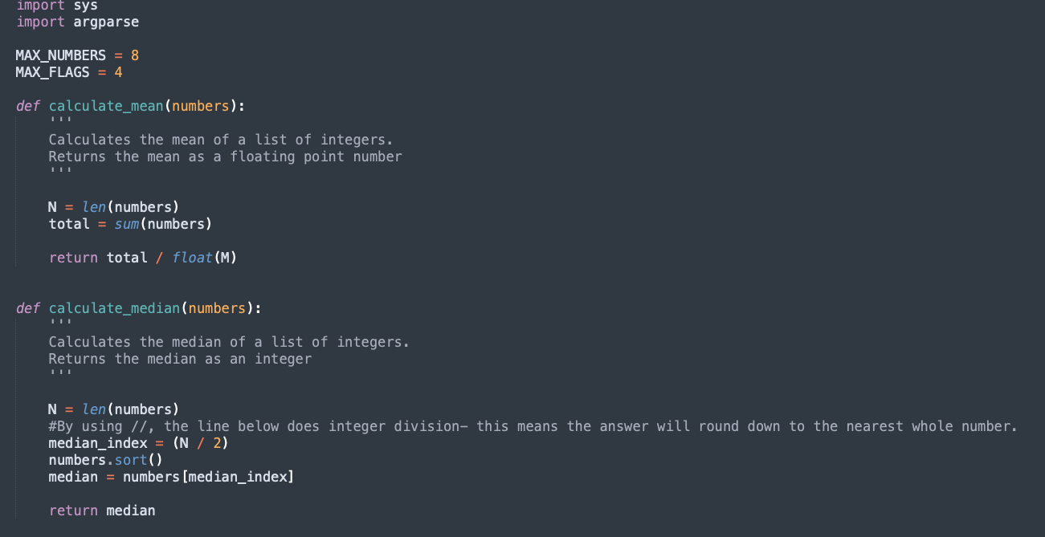
Example
Let’s think about some tests for Consolidation exercise 2 (averages.py)

Slide 9
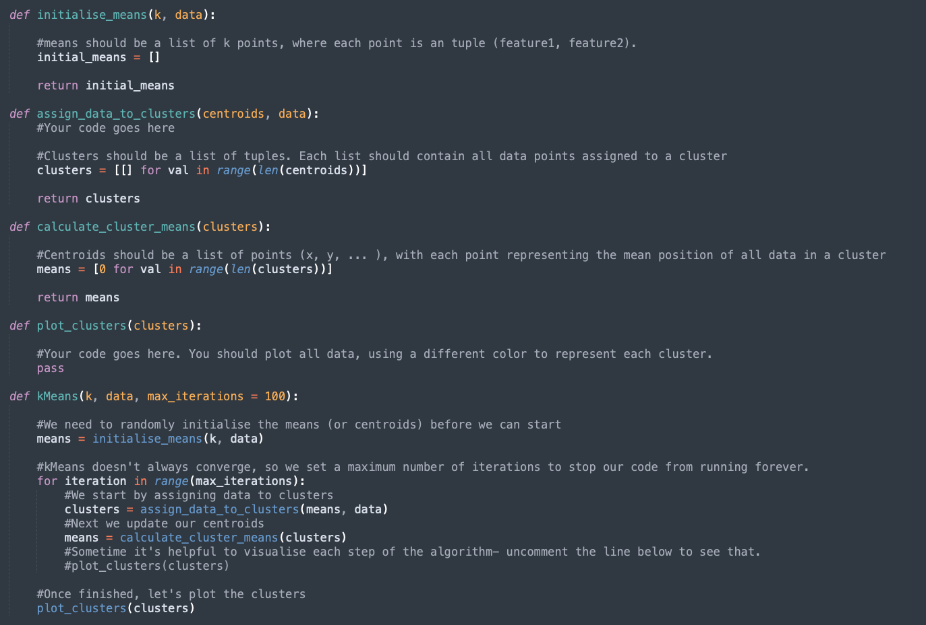
Example 2
Let’s think about some tests for Consolidation exercise 3 (kMeans / KNN)
Which functions should we test?

Slide 10
Example 2
Let’s think about some tests for Consolidation exercise 3 (kMeans / KNN)
Which functions should we test?
  Assign data to clusters
  Calculate cluster means
  kMeans
  Initalise_means

Slide 11
Example 2
Exercise – Write test functions to assign_data_to_cluster and calculate_cluster_means.

Slide 12
Is this code correct?
Does it run without errors?
  If there are errors, how big are they?
Does it produce correct output?
  Does it match the “spec”?
  Can we break it with edge cases?
  Does it pass any tests?
Exercise – Apply your tests to the 3 code samples on Blackboard. Is the code correct? Share your answers on menti.com, code 8660 7357

Slide 13
Is this code easy to understand?
Can I quickly understand ‘how it works’?
Does it adhere to the style guide?
Share your answers on menti.com, code 8660 7357

Slide 14
Is this code easy to understand?
Can I quickly understand ‘how it works’?
Does it adhere to the style guide?
  Are variables named well?
  Does it have any ‘magic numbers’ ?
  Are functions used?
  Does it use comments where necessary?
  Does it follow the correct structure (imports -> constants -> functions -> main)
Share your answers on menti.com, code 8660 7357

